Slide 1
Predicting customer buying behaviour
for British Airways

Slide 2
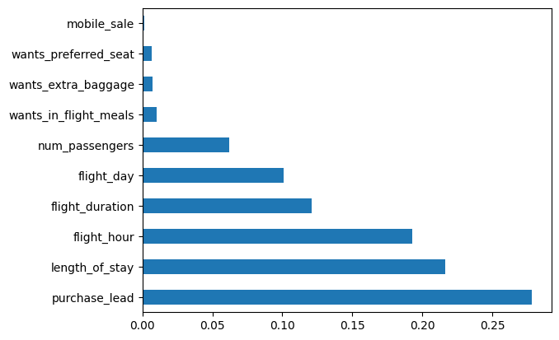
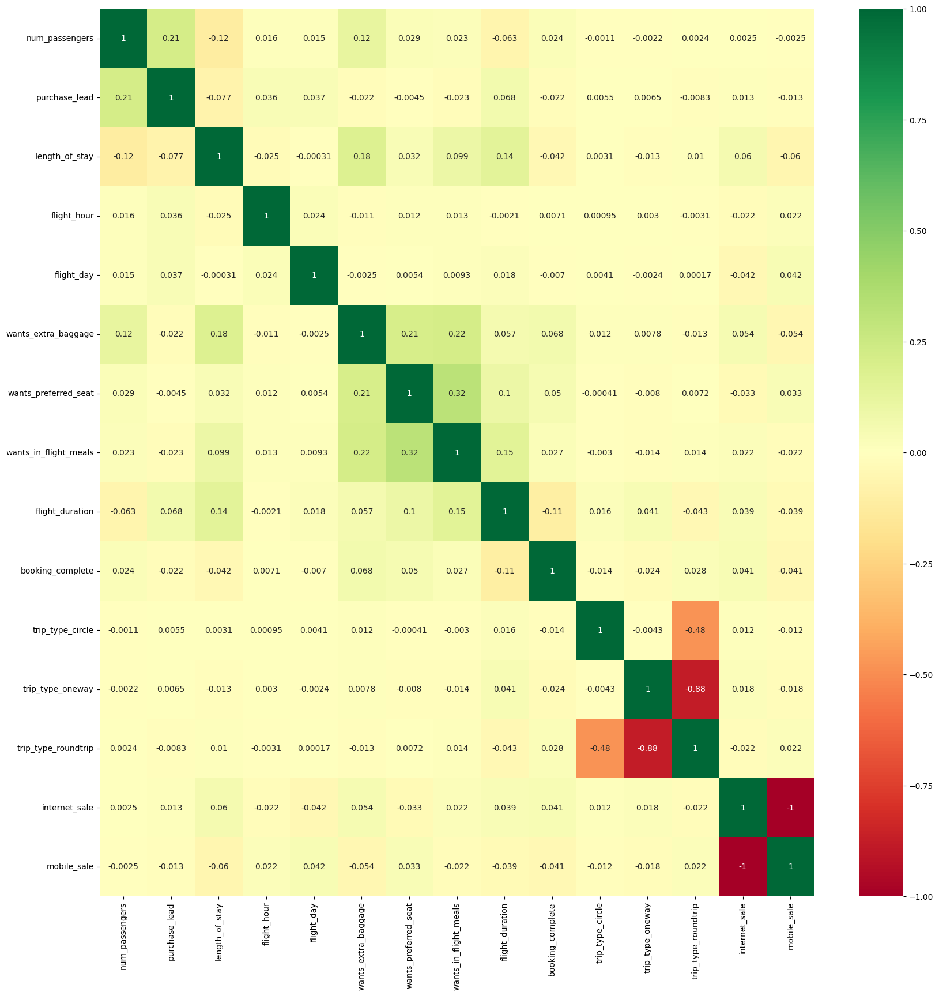
Feature selection findings
Random forest model for selected features
Features | Score
length_of_stay | 4480.96
purchase_lead | 2358.68
flight_duration | 173.83
wants_preferred_seat | 88.29
wants_extra_baggage | 76.89
mobile_sale | 74.82
trip_type_oneway | 29.15
wants_in_flight_meals | 20.13
num_passengers | 19.02
trip_type_circle | 10.34
To create random forest models 3 sets of features were created, to check best possible outcomes:
features_set_1 = ["purchase_lead", "length_of_stay", "flight_hour", "flight_duration", "flight_day", "num_passengers"]
features_set_2 = ["purchase_lead", "length_of_stay", "flight_hour", "flight_duration",
"flight_day", "num_passengers", "wants_in_flight_meals", "wants_extra_baggage", "wants_preferred_seat"]
features_set_3 = ["length_of_stay", "purchase_lead", "flight_duration", "wants_preferred_seat", "wants_extra_baggage",
"mobile_sale"]
Using Sklearn RandomForestClassifier for all 3 models score was the same:
0.85015
To compare the score with different models, Autogluon TabularPredictor model was created. The highest scores were
Feature importance check using inbuilt class feature_importances of tree based classifiers
Selecting 10 best features using the chi-squared (chi²) statistical test for non-negative features
Model | Score
WeightedEnsemble_L2 | 0.85284
NeuralNetFastAI_BAG_L1 | 0.85050
CatBoost_BAG_L1 | 0.85044
Correlation matrix with Heatmap - how features are related to each other

